Slide 1

Sample Superstore Analysis
Chris Andre Sitompul
June 11th, 2022

Slide 2
Content
Introduction
Analysis Result
Recommendation

Slide 3

Introduction

Slide 4
Introduction
Business Understanding
How to increase profitability while reducing the loss.
Data Understanding
Correlation between sales and profit
Impact of cost attribute like discount on profit
Transaction count per sub-category and segment

Slide 5

Analysis Result

Slide 6
Art, Accessories, Fasteners, Copiers, Envelopes, Paper, and Labels sub-categories have above-average profit-margin.
*Profit Margin = (Sum of Profit / Sum of Sales) *100

Slide 7
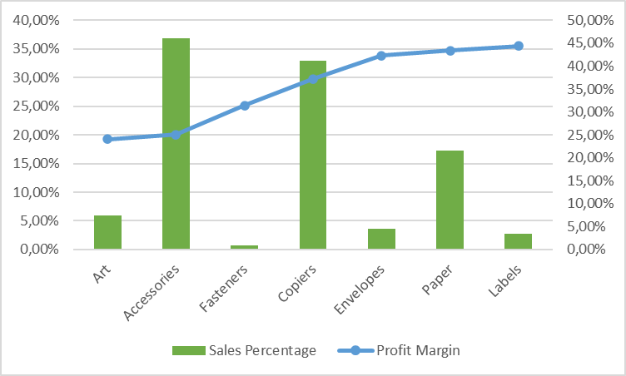
Art, Fasteners, Envelopes, Paper, and Labels sub-categories have a big gap between profit margin and the sales percentage.

Slide 8
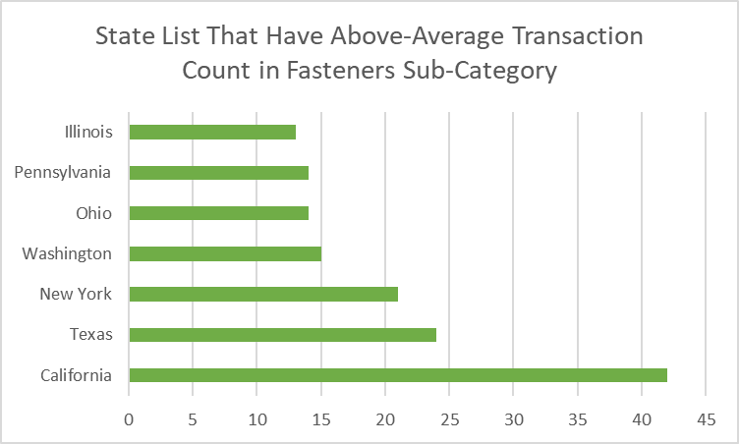
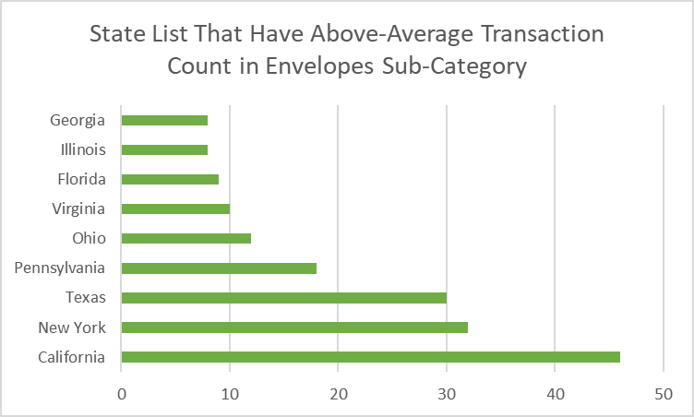
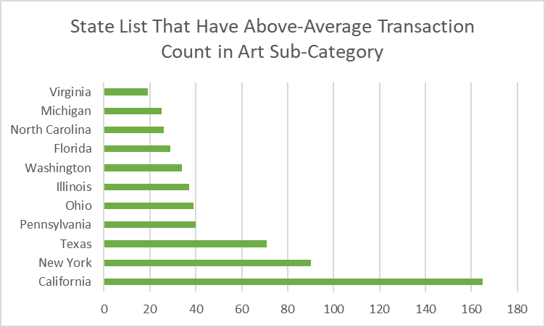

Slide 9
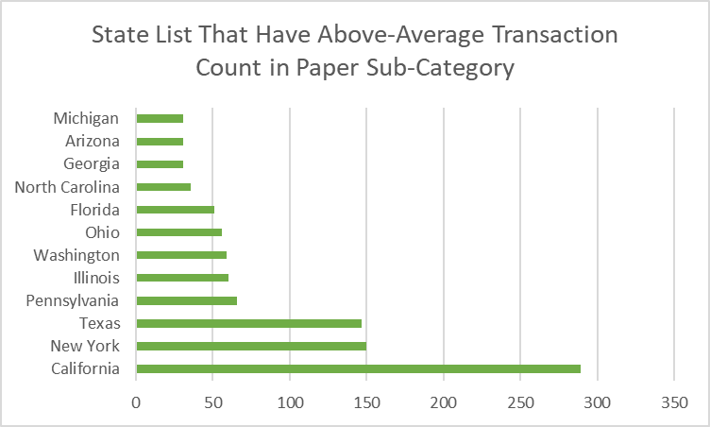
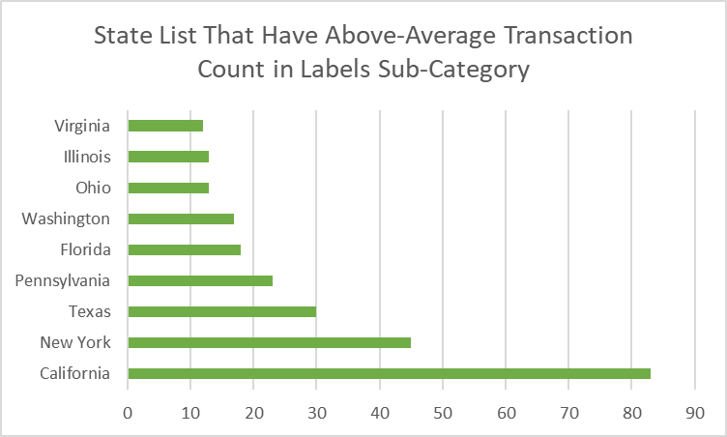

Slide 10
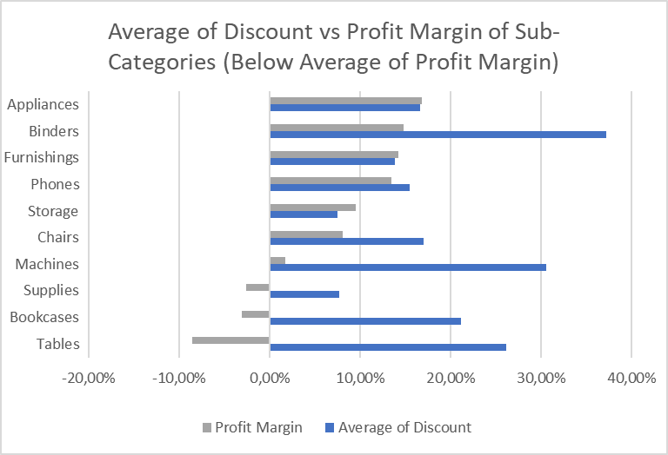
Binders, Phones, Chairs, Machines, Supplies, Bookcases, and Tables sub-categories discount average higher than those profit margin.

Slide 11
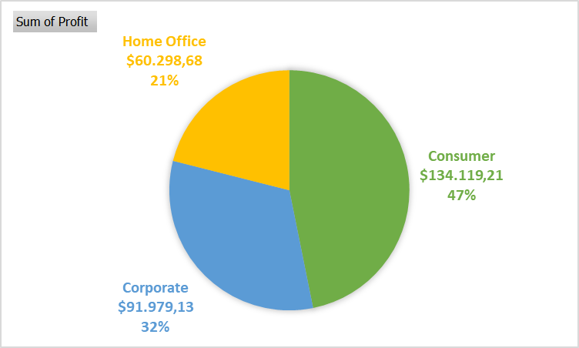
The most profitable segment is Customer.

Slide 12
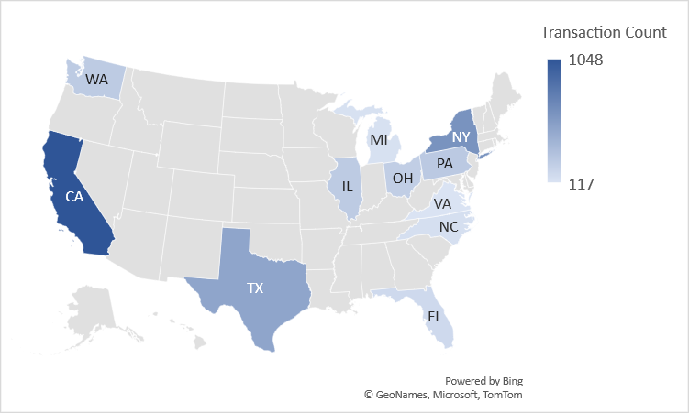
List of state that have above-average transaction count in consumer segment:
California
New York
Texas
Pennsylvania
Illinois
Washington
Ohio
Florida
North Carolina
Michigan
Virginia

Slide 13

Recommendation

Slide 14
Recommendation
The company needs to increase sales in sub-categories that still have a big gap between the sales percentage and profit margin.
The company needs to increase sales of sub-categories that have above-average profit margins, in states that still have above-average transaction counts.
The company needs to reduce the discount amount on sub-categories that have below-average profit margins.
The most profitable segment is consumer, so the focus of sales in that segment needs to be increased and focus on states that have an above-average transaction count for that segment.
The category from 6 of 7 sub-categories that have an above-average profit margin is office supplies, so the company can increase the focus on sales in the office supplies category.

Slide 15

Thank you

